Slide 1
FATIGUE
Fatigue Strength and Endurance
S-N Curves

Slide 2

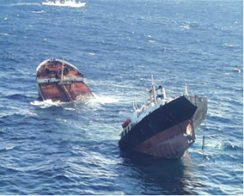
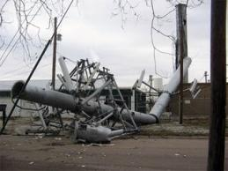

Examples of Fatigue

Slide 3
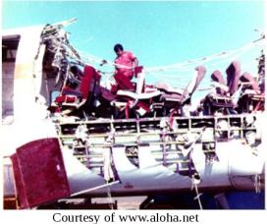
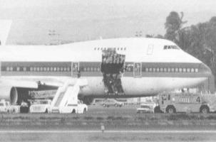

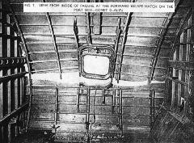
Aerospace Examples of Fatugue

Slide 4
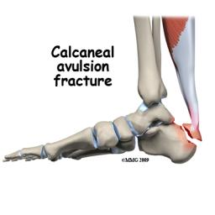
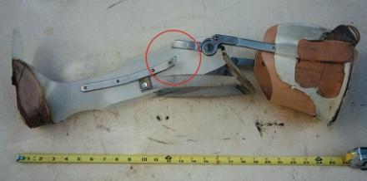
Biomedical Examples of Fatigue

Slide 5


Energy Examples of Fatugue

Slide 6
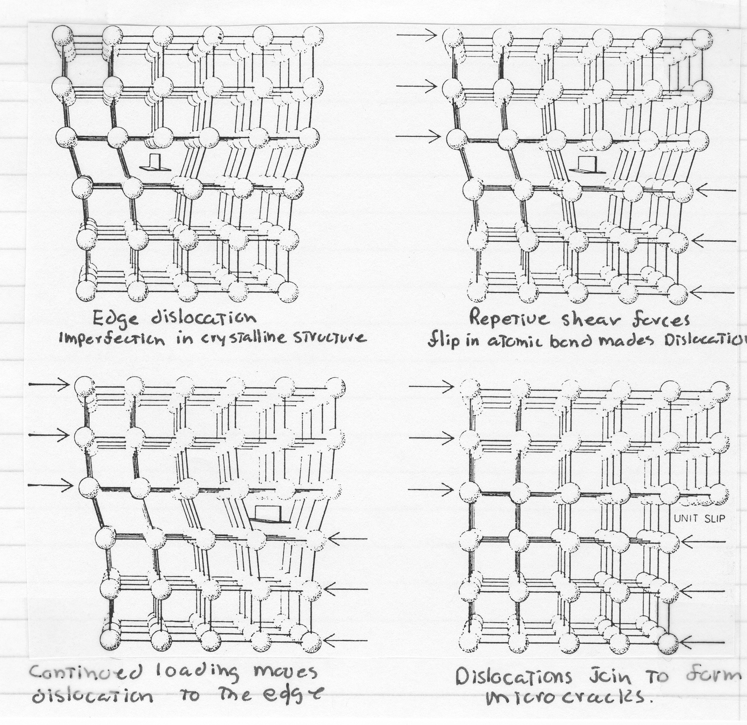
Stages of Fatigue Fracture Initiation
Most Complex
Most Studied
All Materials have Flaws
Edge Dislocation Imperfections
In crystalline structure
Repetitive Shear Forces cause Flip in
Atomic bonds that make Dislocations Jump
Continued Loading Moves
Dislocations to the Edge
Dislocations Join
to Form Mircocracks

Slide 7
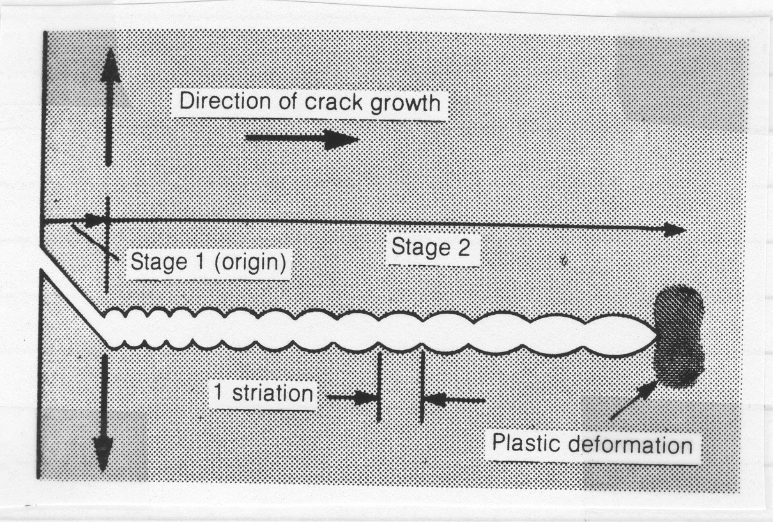
Stages of Fatigue Fracture Propagation

Slide 8
Stages of Fatigue Fracture Rupture
Crack Propagates to Final Failure
Perspectives
Phenomenological
Fracture Mechanics

Slide 9
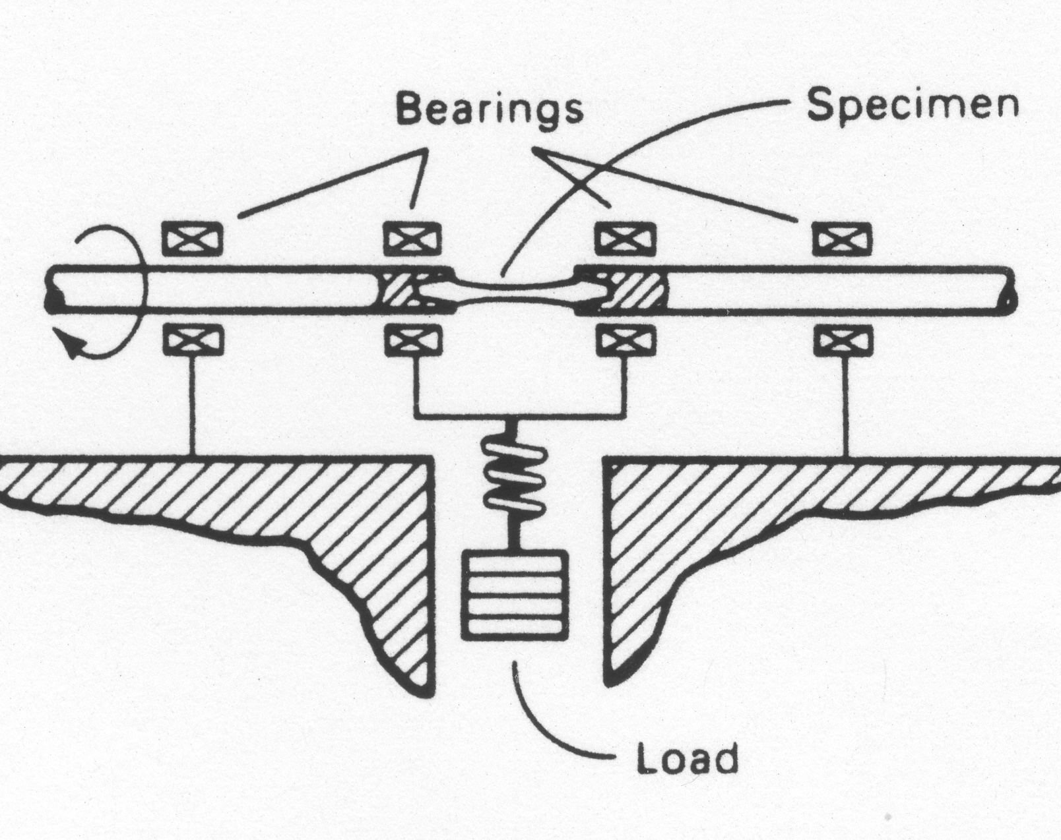
Fatigue Strength and Endurance Limits
Repeated or varying loads
Specified Magnitude
R.R. Moore Machine
Compression
l
l
y
Tension
d
x

Slide 10
Fatigue Terminology
Stress Ratio
A=σ_{amp}/σ_{ave}
R= σ_{min}/σ_{max}
CYCLE
STRESS
NUMBER OF CYCLES

Slide 11
Example #1
For the beam below determine
Stress ratio
Mean stress
Stress range
Stress amplitude
y
3 in
4 in
3 in
x

Slide 12
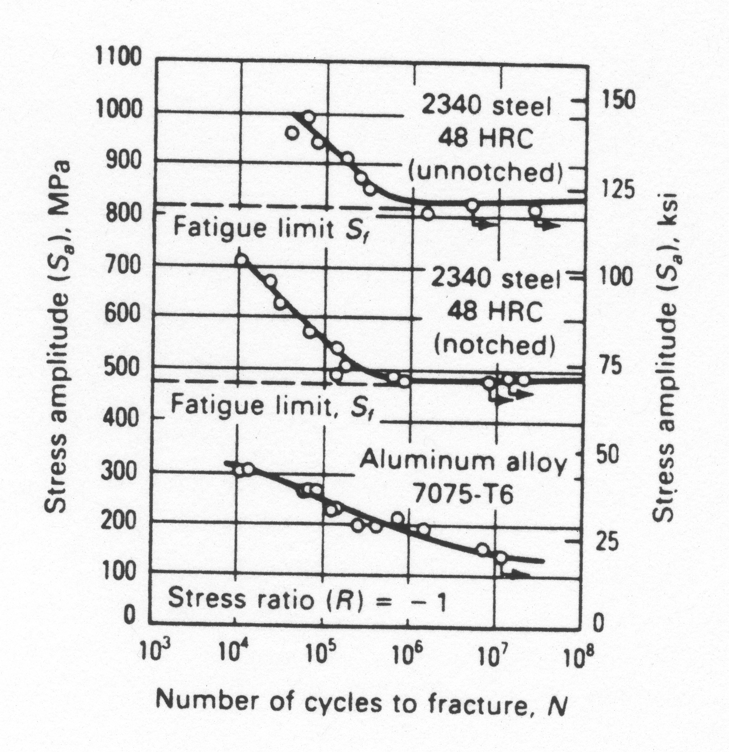
S-N Curves
Results of a fatigue test

Slide 13
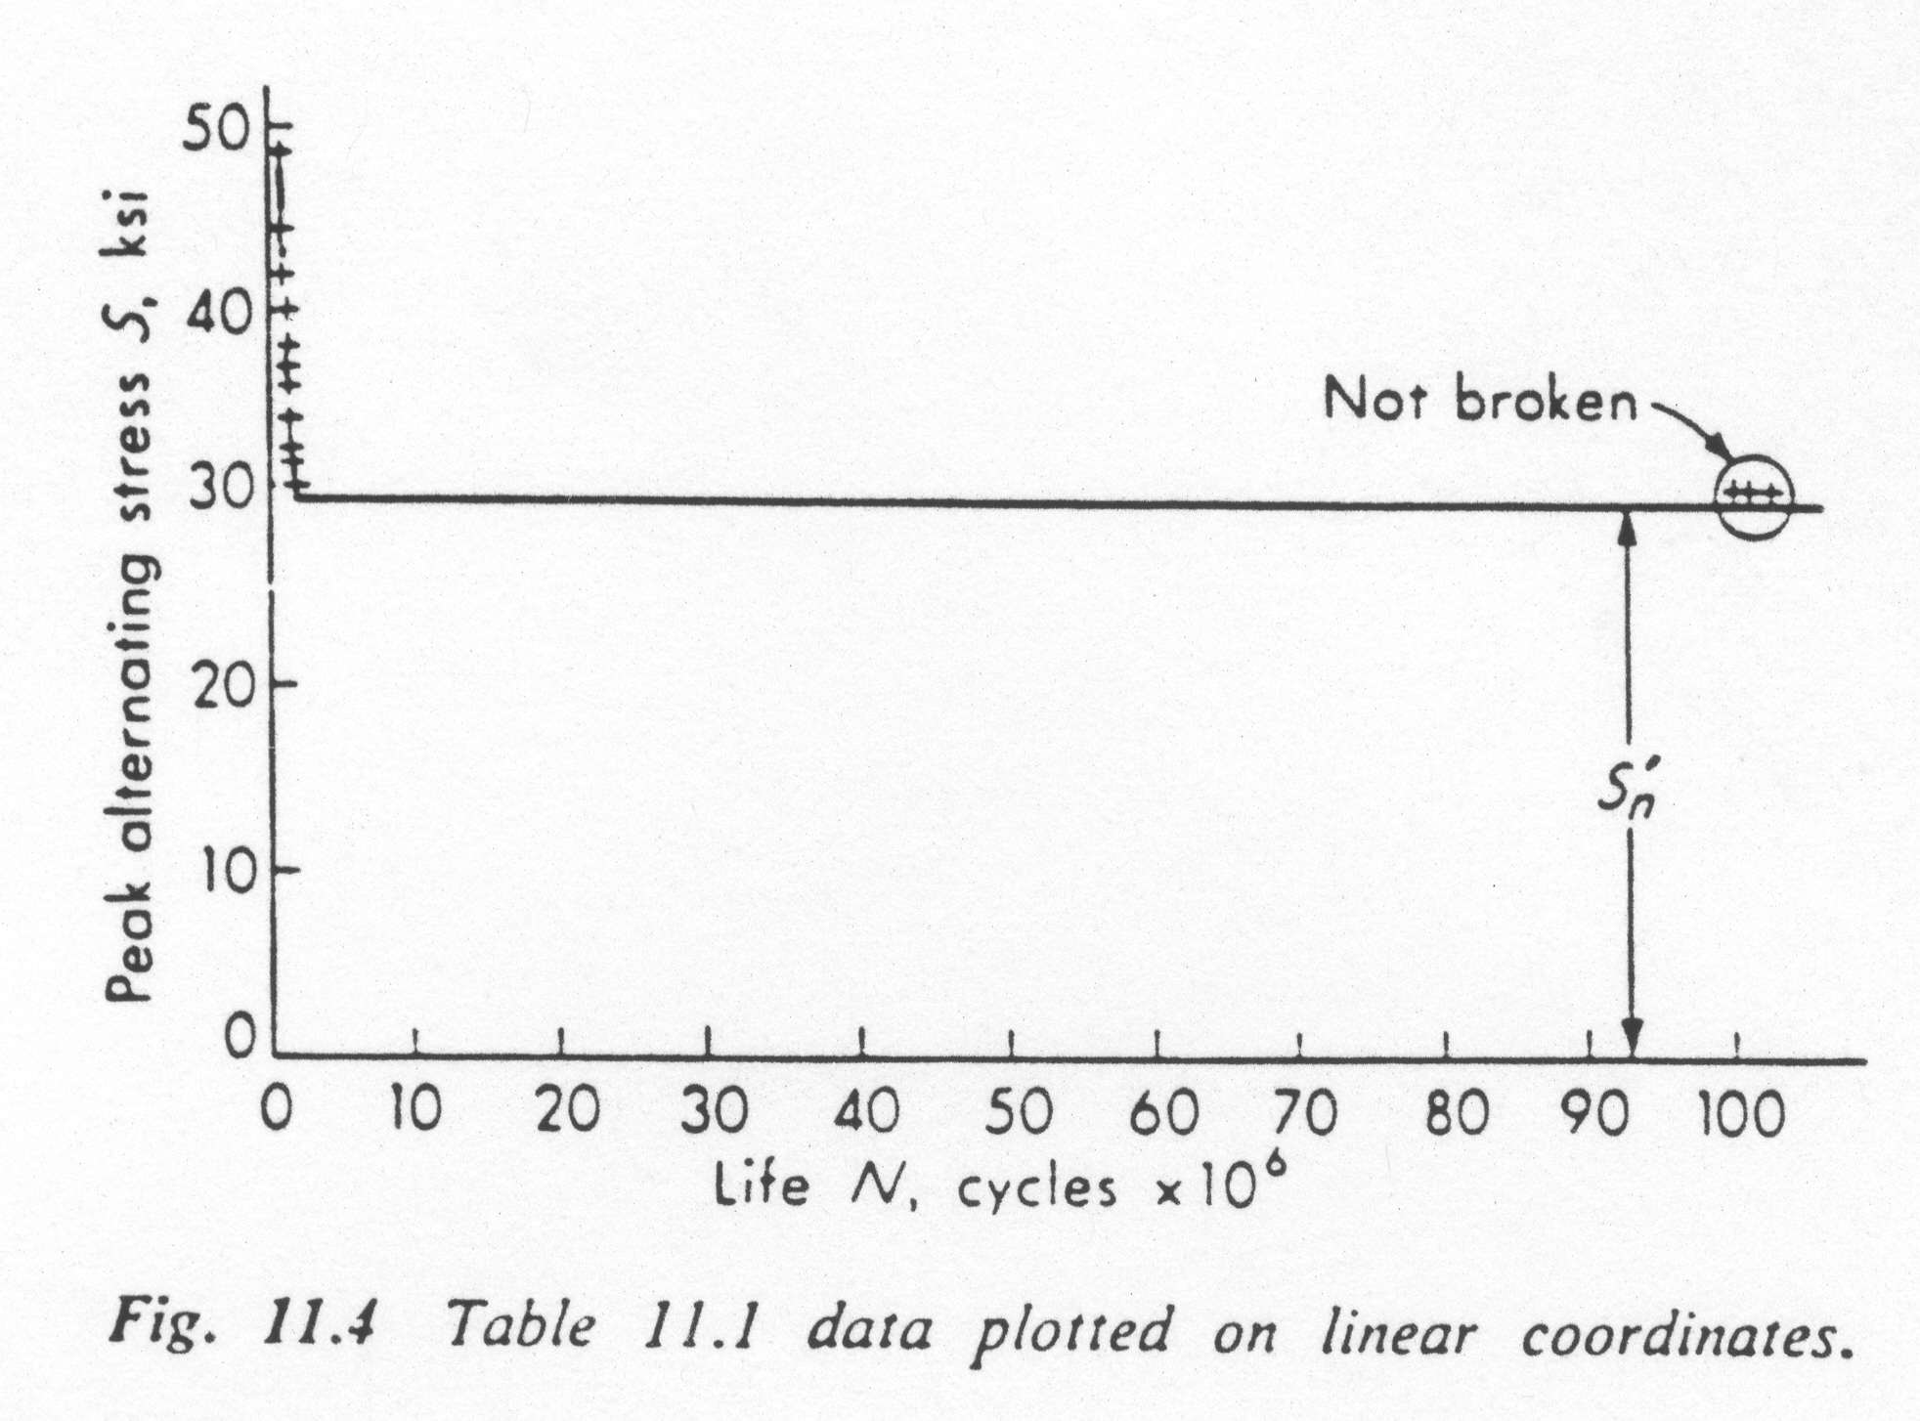
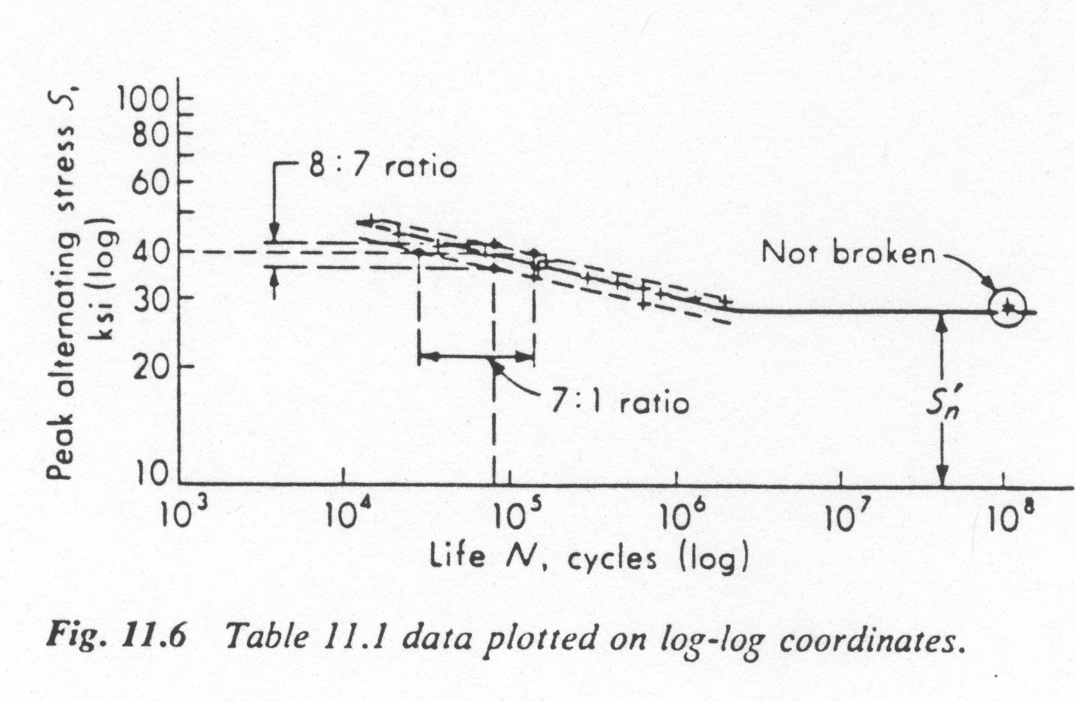
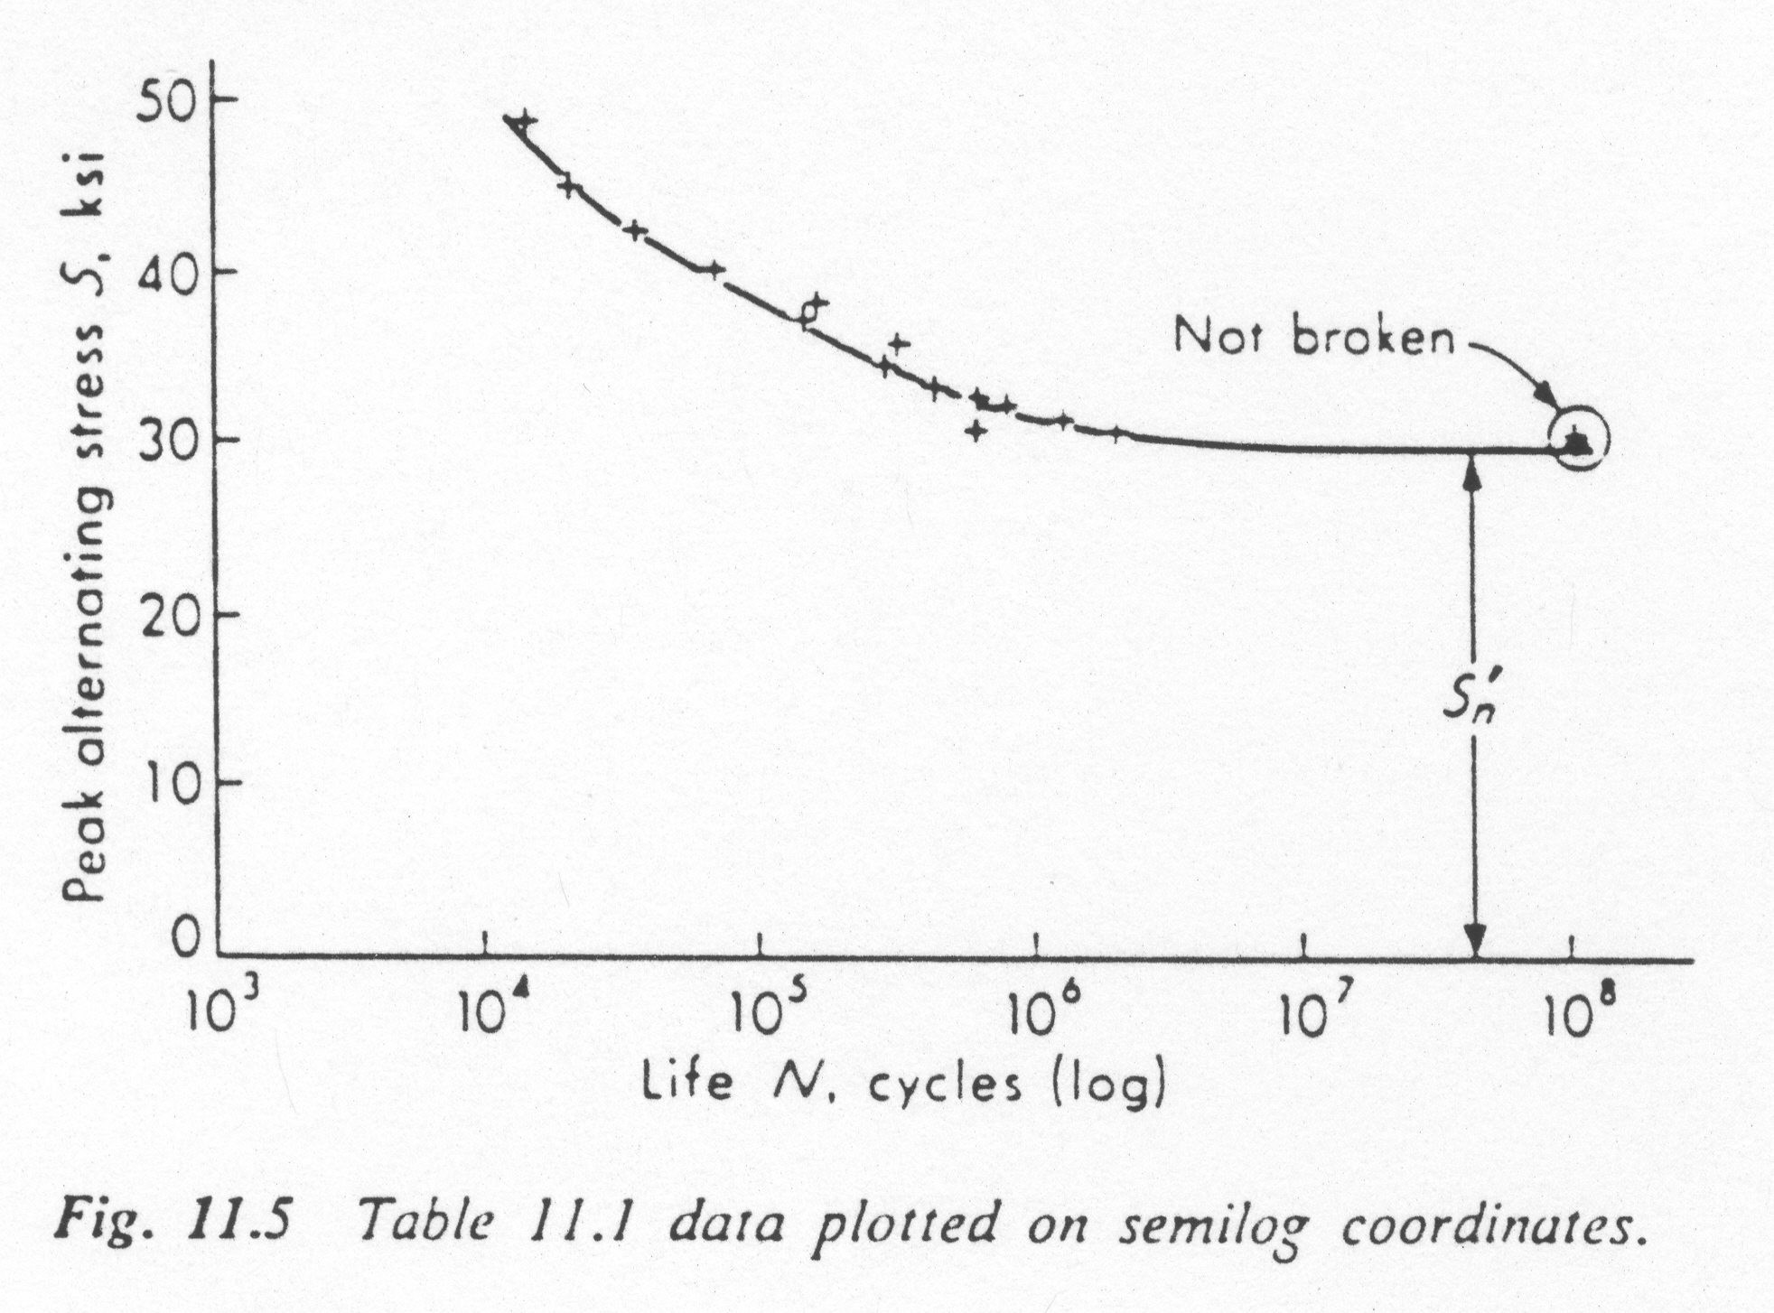
Scales used

Slide 14
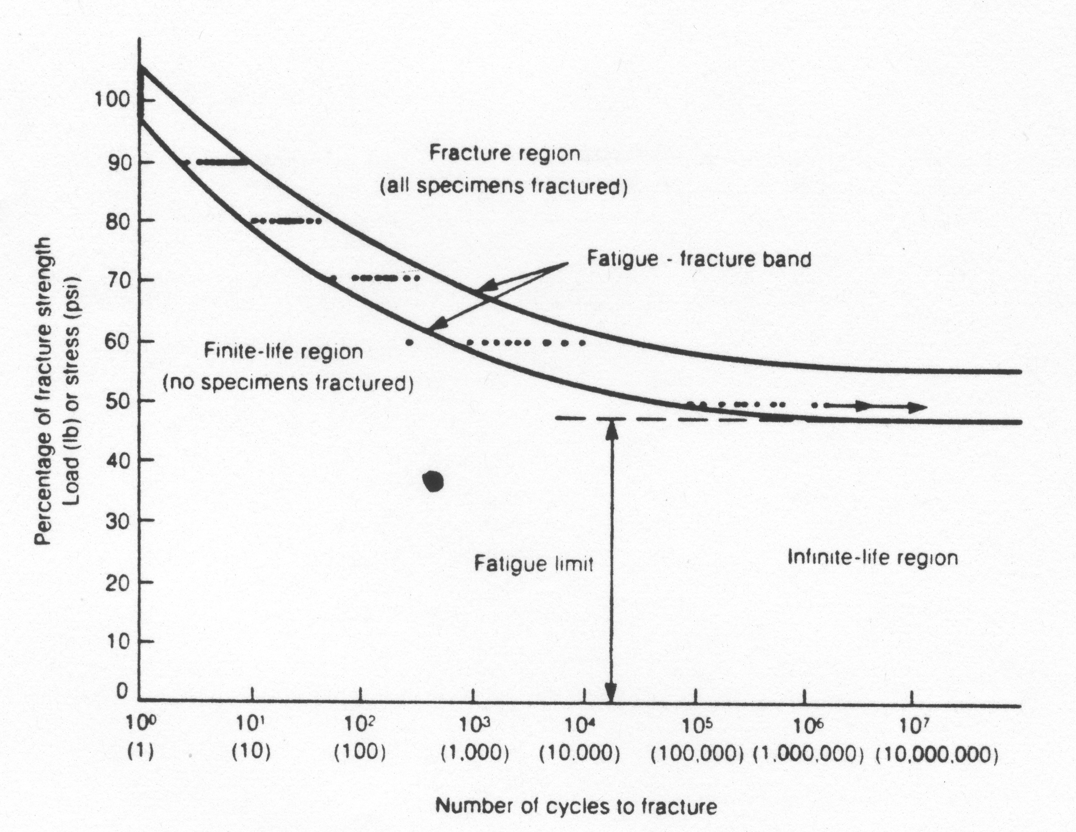
Fatigue Strength and Endurance Limit

Slide 15
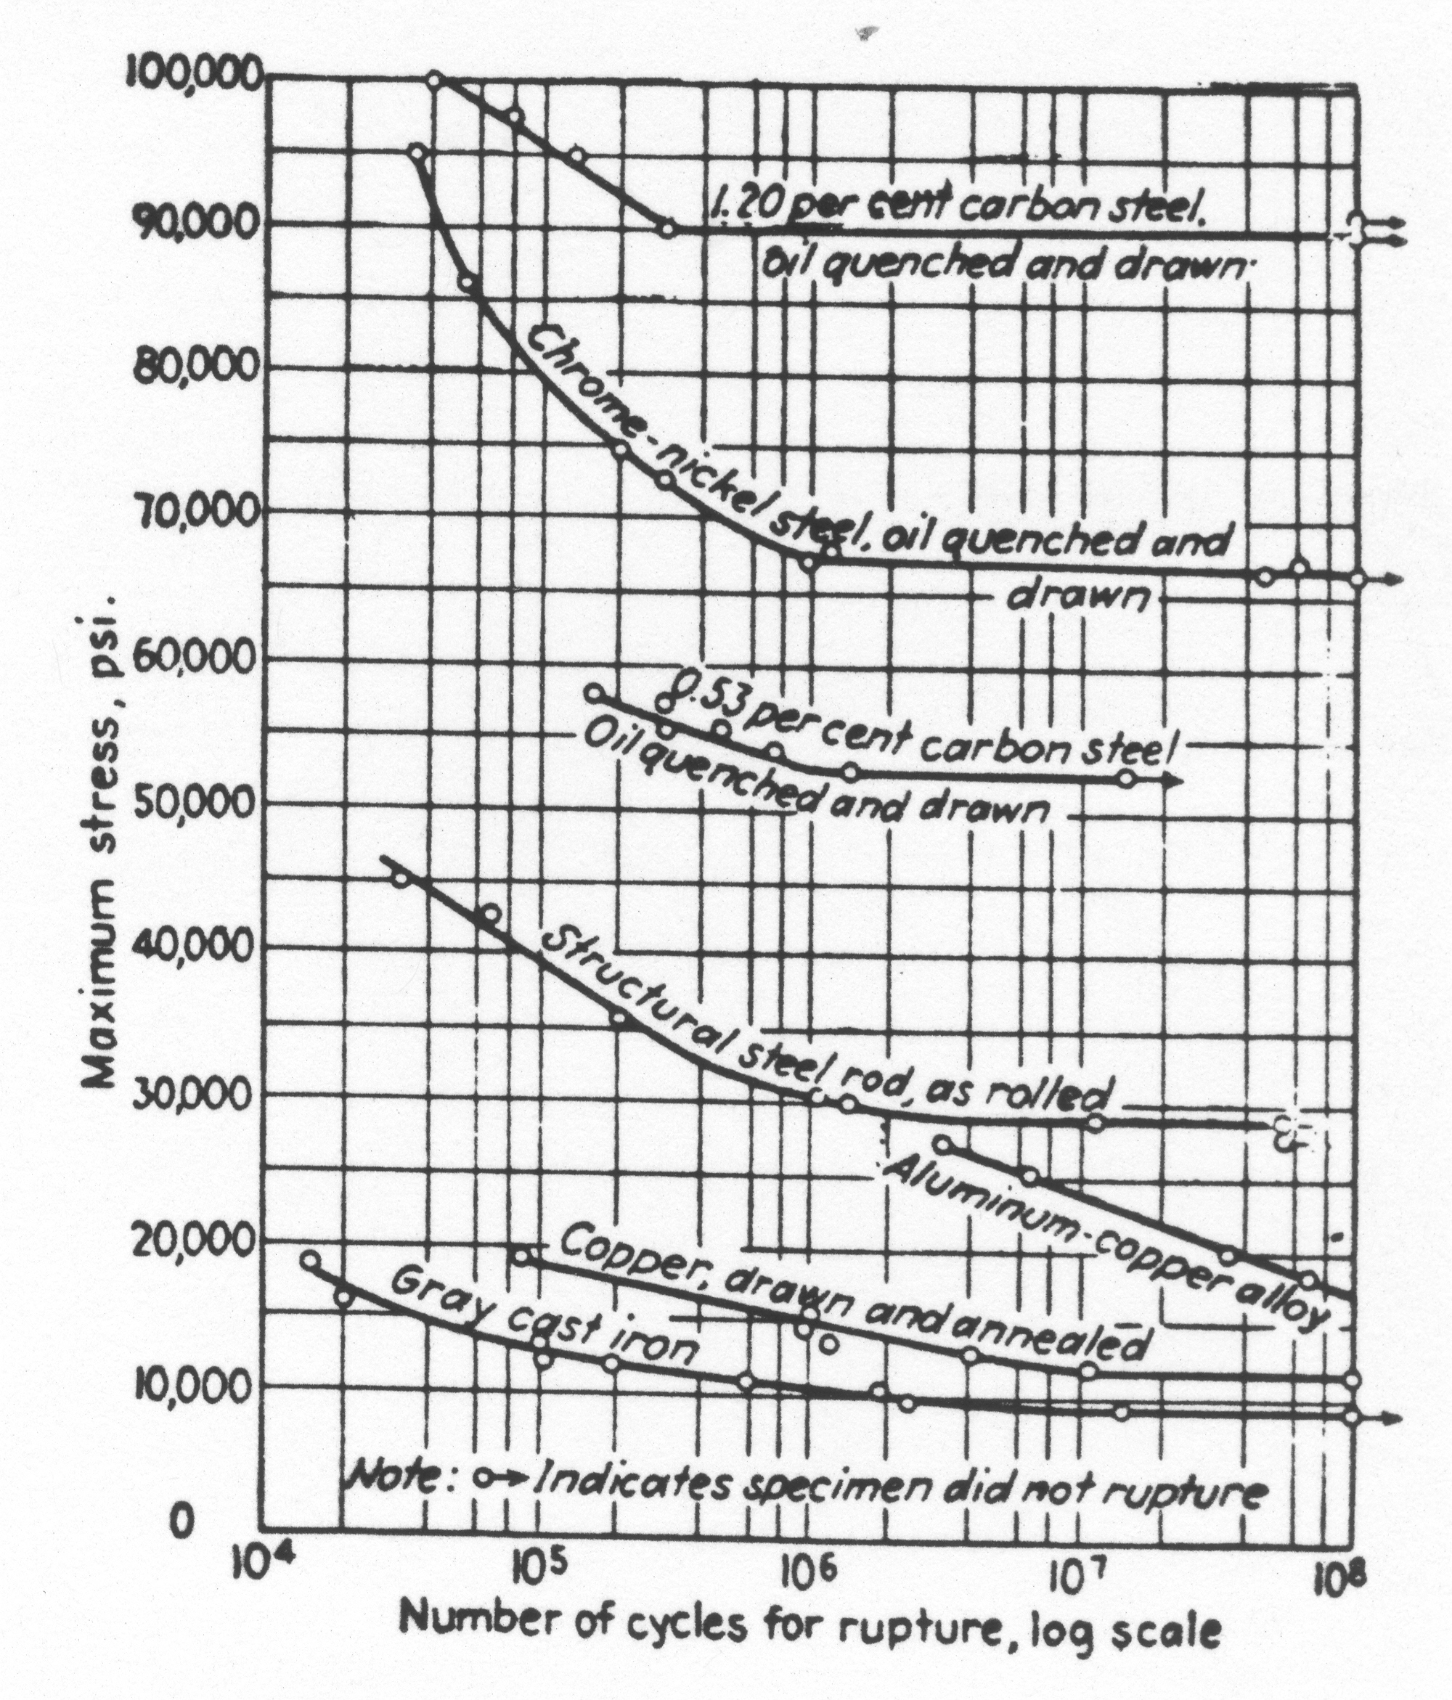
Material Behavior

